Slide 1
Software
Grade 12 CAT

Slide 2
What is software?
A program is a collection of instructions to do a job.
Programs are collectively known as SOFTWARE.
The people who write programs are called PROGRAMMERS.
Notes:
Concept of single user vs multiple users including examples
Concept of multitasking including examples
Concept of Task Manager (Windows)
Management of files: File types, properties, file attributes such as read-only and hidden as well as metadata such as the author and title properties of documents, import, export, search and conversion
Operating system utilities (what is it? why is it needed?):
File management
Schedule/update
Coordinate tasks - Concept of spooling when printing
Compress/decompress files and folders
Security features such as access control, control of spyware, adware and firewall
Backup
Anti-virus software
General troubleshooting using utility software
e.g. defragmentation
Factors that influence performance such as:
RAM
Type of processor, processor speed
Number of applications running and caching
Hard disk space/fragmentation
- Influence of malware - Basic concepts/non-technical

Slide 3
Types of Software
Systems
Application

Slide 4
Sets the standards by which the system will work
Hardware needs these in order to work
Helps us work with the computer

Slide 5
Systems Software
Is an interface between the computer and other programs.
Examples are:
  BIOS
  DRIVERS
  Operating Systems
  Utilities

Slide 6
BIOS – Basic Input Output System
Stored on the BIOS chip
Controls
  the boot up process
  the input and output
It runs the POST (Power On Self Test) program which makes sure that all attachments are working.
It loads the operating system.

Slide 7
Drivers
Drivers help hardware items to work with your system and with each other.
“Plug and Play” (PnP) means that the driver is already on your system.
If the driver is not found, you need to install it from a disk or the internet.

Slide 8
Operating System
In computing, your application and utility programs have to have a platform from which they can perform.
That platform is your Operating System.
It is an interface between the Software and the hardware
It is the most basic component allowing you to work with your computer programs.

Slide 9
Utility Software
These useful programs are often called “housekeeping” programs.
They help manage and troubleshoot problems
  Recycle Bin
  Defrag
  Disk Cleanup
  Scan disk (error checking)
  Anti-Virus
  Backup
  Wizards
  Task Manager

Slide 10
Recycle Bin
Deleted items stored here.
Can be restored or permanently deleted.
When full, the oldest files will be deleted in first (FIFO – First In First Out).

Slide 11
Defrag
Sometimes your hard drive will take long to load a file.
Files become fragmented as they increase in size.
We can defragment our hard drive by using the Defrag program.
The scattered data on your hard drive is reorganised so that no file is fragmented.
This will make your computer run more efficiently.

Slide 12
Disk cleanup
Helps you
  to sort through and
  delete unused and temporary files,
This frees up space on your hard drive
speeding up its operation.

Slide 13
Scan Disk – (error checking)
Detects errors.
The program will give you a report of the number and types of errors it has found
It can repair some of these errors
  "soft" errors →the magnetic signal on the disk is weak or the formatting is bad
  "Hard" errors → physical damage to the disk → cannot be repaired.
Using this utility could give you advance warning of a hard drive crash giving you time to back up all your important files.

Slide 14
Anti Virus
These programs are needed if you:
  browse the internet
  Receive and open e-mail attachments
  Borrow disks from friends or
  Use your USB on many computers.
Anti-virus programs:
  Some can be downloaded free
  Some will slow your system down
  Some are inefficient and allow viruses to sneak through.
Update your virus definitions frequently. Your Anti Virus program could:
  Delete the virus
  Quarantine it → it will be on your computer but it will be ineffective.

Slide 15
Backup
Storage devices crash.
  Frequently back up important work by:
    copying your files to another storage medium
    running a backup program to compress the files

Slide 16
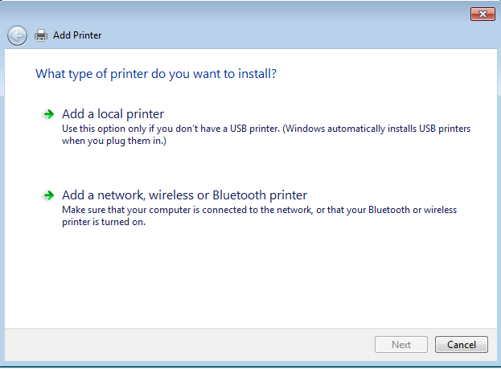
Wizards
A Wizard is a sequence of steps that help you do a task. To pass from one step to the next, the step must be completed and the button marked NEXT must be clicked.

Slide 17
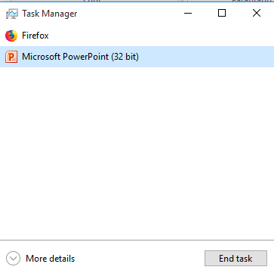
Task Manager
This manages tasks (as the name implies). We can use it when a program stops responding or simply to see what program may be using too much of the resources.
To activate the task manager press CTRL+ALT+DELETE and choose Task Manager
Or
Right Click the task bar and choose Task Manager.
If you select more details you get various tabs which allow more control.
You can see the performance of the CPU
You can see which programs are in Startup

Slide 18
Spooling – background info
SPOOL → Simultaneous Peripheral Operations On Line
Buffer → temporary storage area
Queue → jobs line up waiting for their turn
FIFO → First In First Out

Slide 19
Spooling
When we talk of Spooling we will usually be talking of print jobs.
When we send work to the printer it gets stored in a buffer and as the printer is ready to work on it, it is spooled to the printer’s buffer area.
When the printer’s buffer empties it requests more data from the computer. This could be more of the same file or it could be the next print job.

Slide 20
Printer control
All printers have an on-board card that controls communication with a connected computer. This is known as the printer controller.
It establishes communication with the computer and controls the amount of data it can handle at a time.
If it is a networked printer, it will have to keep control of several computers and facilitate their access.

Slide 21
File Compression
File compression is used when we need to make files smaller in order to save disk space or send them via email.
Most compression programs can compress several files into one “package” which can be unpacked on the receiving end.
There are many compression utilities but the most popular for Windows users is Winzip

Slide 22
Application Software
Is an interface between us and the computer
it helps us to do a task.
Application programs make the computer a multi-function tool.
Application programs include:
  A word processor
  A spreadsheet
  Computer games
  Educational programs

Slide 23
Application types
Licensed
Shareware
Freeware
Open Source
Public Domain

Slide 24
Licensed Software
When you buy software from a vendor, you buy a license for that software.
You can install it on one computer only. There are a few licenses that will allow you to install it on two computers AS LONG AS ONLY ONE COPY OF IT WILL BE USED AT A TIME. The penalties for abusing a license are strict.

Slide 25
Licensed Software (2)
If you wish to use the software on many computers, it is necessary to buy either a copy of the software for each computer or a site license to load the program on a certain number of computers. This is usually the better deal because a license for 10 copies costs less than buying 10 copies of the program.

Slide 26
Licensed Software (3)
Usually you will be required to register the software that you purchase. There will usually be a registration form for you to fill in and will usually be done online.

Slide 27
Advantages of registering software
You will be informed of product updates and
You may get additional facilities for the program like extra fonts etc.

Slide 28
Shareware –”Try before you Buy”
You may get:
The full package but it may be “date stamped”. This means it begins a count down from the day it is installed. A screen display will give details such as the author’s name and address and the cost to register the program
A trial version of the package which gives a good indication of its worth and scope but is not the full version. Details of the author will be given should you wish to purchase the full copy.

Slide 29
Shareware (2)
A lot of shareware is very good quality. If you like the shareware, you can pass it on to a friend with no strings attached.
You may not
Change the program in any way or
Sell the program

Slide 30
Freeware
Often found on the Internet.
It is free for you to use and to give away to others
BUT the author holds the copyright so no changes can be made to the program and you cannot redistribute it for a price under your own banner.

Slide 31
Open Source Software (OSS)
Software that is accessible to the public and is usually free
The code can be made available to people who wish to manipulate or examine it.
It has a license which encourages users to share any modifications made
The software can be shared freely as long as users abide by the terms of the license.

Slide 32
Public Domain Software
Essentially means “No License Required
Free
It is not copyrighted
Source Code is freely available
Can be given to others
Changes can be made to it if you wish BUT you are expected to share any improvements.
It can be considered as a subset of Open Source

Slide 33
Software Piracy
Software Piracy is the running of illegal software on a system.
It does not matter how the program arrived on the system, if the owner of the system does not possess a license for the software then the software is illegal.
Piracy is punishable by law. Heavy fines are imposed on anyone caught with illegal software on their system.

Slide 34
Malware
Malware → Malicious Software
This software usually enters your computer via a downloaded file. It includes:
  Spyware → programs that grab info from your computer that can be used against you
  Keyloggers → records and stores keystrokes to gain access to banking etc.
  Viruses (worms, Trojan Horses)
  Adware → banners and or popups that could lead to nasty places
  Bots → a computer program that searches and crawls through the internet. Often used by criminals to spy on you
Ω

